Slide 1
EU Accounting and Audit Directives: Overview
Henri Fortin
Head, Centre for Financial Reporting Reform
UPFAA Conference – Kyiv, 17 December 2014

Slide 2
  EU Accounting Directive: key changes
New Accounting Directive (2013/34/EU) adopted on 26 June 2013
Motto: simplification, comparability, clarity!
  Merging and modernising the previous Accounting Directives (4th and 7th)
  Introducing uniform categories and definitions
  Harmonising simple regime for small companies
  Providing relief for micro entities (optional)
  Adding new requirements
Notes:
* - implementation within 3 years of the AA entry into force (i.e. 2017)

Slide 3
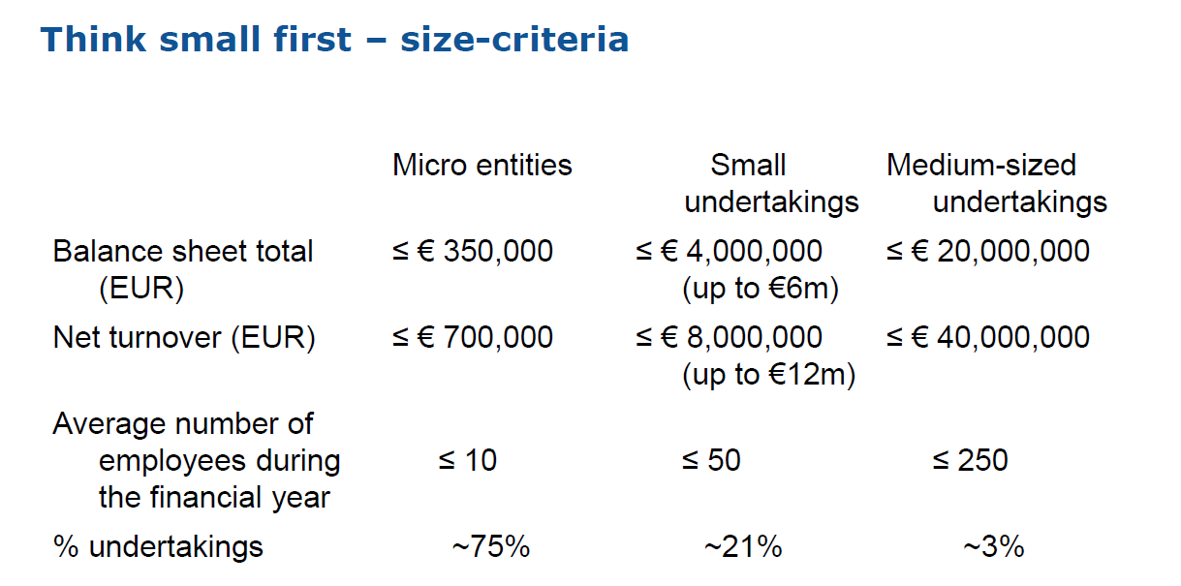
Accounting Directive 2013 and its key changes
Definition of micro, small and medium size businesses as per Accounting Directive of the EU (2013):

Slide 4

Accounting Directive 2013 and its key changes
  Small undertakings:
  Introduction of a mandatory « safe harbour »;
  Obligation to address small undertakings (<50 employees) in each Member State: best way to do this: to define this size-category;
  Micro-undertakings (<10 employees) are in the small size category, unless stated otherwise in the legislation of a Member State (see below)
  « Gold plating » is not possible: the Directive spells out which information and which statements should be prepared by small undertakings.
Source European Commission

Slide 5
Accounting Directive 2013 and its key changes
  Micro undertakings:
  Within the small regime, introduction of an option to simplify further;
  If a Member State implements one of the simplification option: need to distinguish micro-undertakings. Best way to do this: to define this size-category;
  The Directive spells out the minimal regime that can be implemented;
  Flexibility on the degree of simplification, depending on each Member State.
Source European Commission

Slide 6
Accounting Directive 2013 and its key changes
Limitation of Notes to the financial statements
Source European Commission

Slide 7
Accounting Directive 2013 and its key changes
  Scope: more rules based with foreign entities in chain
  Definitions: whole new set of definitions, including:
    Participating interest, related party, group, material…
  Size-categories: uniform size-categories have been introduced per category (micro, small, medium and large). The regime for micro and medium-sized undertakings is an option for Member States
  Public interest entities:
    Listed companies
    Banks
    Insurance companies
    … and entities defined by a Member State (rare).
    Should be treated as large, whatever the size - unless exemption permitted
  Formalised accounting principles: eight principles, including materiality…

Slide 8
Accounting Directive 2013 and its key changes
  No reference to the IFRS for SMEs in the Directive
  No prohibition either
  Two hurdles to its adoption
    Possible incompatibilities (e.g., uncalled capital)
    For small companies: disclosures in the notes exceed the requirements of the directive
Notes:
No reference to the IFRS for SMEs in the Directive
The standard would not serve the objectives of simplification and the reduction of administrative burden for SMEs
It is not a clear option offered to Member States
No specific prohibition either:
Member States may consider IFRS for SMEs as the basis for their standard
However two main hurdles
Main hurdle 1, for all companies:
Need to check compatibility of the IFRS for SME standard (including the next version to be published in 2014 or 2015) with the new Accounting Directive
In particular, the following differences need to be assessed (there may be more!):
presentation of unpaid subscribed share capital in the balance sheet
Amortisation of goodwill (?)
The compatibility check is the Member State’s responsibility
Main hurdle 2, for small companies:
The IFRS for SME standard is more demanding than what is permitted by the simplified regime in the Directive. For instance, no cash flow statement.
In this way, some Member States may offer the IFRS for SMEs or similar standard as a voluntary option for small companies

Slide 9
Accounting Directive 2013 and its key changes
From adoption to application
From adoption to application
July 2013
July 2015
2016
Entry into force
Transposition deadline
1st full application by companies (or earlier)
Notes:
Implementation challenges
Technical and compliance (e.g. new concepts, new principles, new approaches)
Timing (not foreseen yet)
Other (not foreseen yet)
Proposed support actions
Dedicated functional mailbox for communication
Holding bilateral and multilateral meetings upon request
Holding transposition workshops
Creating a specific intranet website with restricted access
Transposition activities began
No problems of compliance foreseen at deadline
The most active support actions / implementation tools:
Transposition workshops
Dedicated functional mailbox

Slide 10
  Recent Amendments to the Statutory Audit Directive

Slide 11
Key messages from recent changes
Restoring the confidence of investors in financial information
The revised Directive includes measures to:
  strengthen the independence of statutory auditors
  make the audit report more informative, and
  strengthen audit supervision throughout the EU
The Regulation - stricter requirements on the statutory audits of public-interest entities, strengthen independence and professional skepticism, and limit conflicts of interest
2 years to implement the revised Directive. The Regulation will also become directly applicable in mid-2016
The EC will work with the Member States, the national supervisory bodies, and the stakeholders to facilitate a consistent and effective implementation of the new rules across the EU

Slide 12
Main changes in the Audit Directive
Governance of firms and independence rules
Auditing standards and Reporting
Public oversight and delegations to professional bodies
Quality assurance
Investigations & sanctions

Slide 13
Governance of firms and independence rules
  Detailed requirements on the organization and the internal quality assurance system of audit firms
  Obligation to assign an audit partner to each engagement who participates actively to the audit and signs the audit report
  More specific on independence rules (some threats identified)
  Application of independence rules to any natural persons in a position to directly of indirectly influence the outcome of the statutory audit
  New rules on employment of former statutory auditors by the audited entity

Slide 14
Auditing standards and Reporting
  International standards clarified meaning: ISAs, ISQC 1 and related standards issued by the IAASB
  Application of standards in smaller audits may be proportionate to the scale and complexity of the activities of the audited company
  Statutory audit is not mandatory for small companies in the EU
  Scope of the requirement for statutory audit is fixed by the Accounting Directive

Slide 15
Public oversight and delegations to professional bodies
  Competent authorities governed by non-practitioners have the ultimate responsibility for the oversight of the profession
  All statutory auditors and audit firms subject to PO
  May delegate (or allow the competent authority to delegate) any of its tasks to authorized institutions
  Note. Restrictions related to PIE audits and auditors - regulation

Slide 16
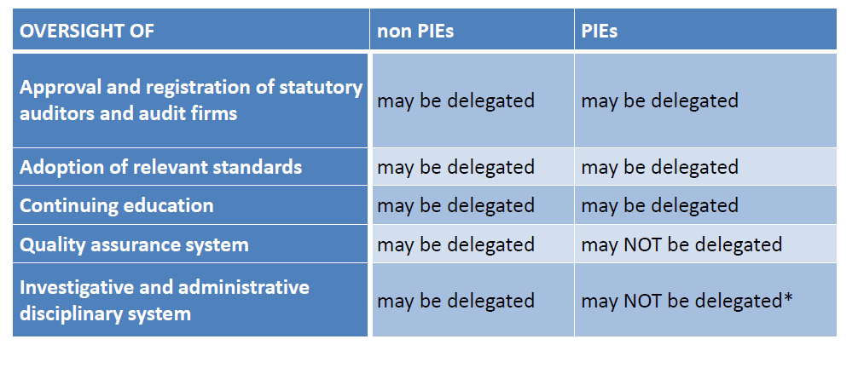
Public oversight
* - Member States are provided with an option to delegate the tasks related to sanctions and measures, but only to a body independent from the profession
Source: European federation of Accountants (FEE)

Slide 17
Main new issues in the Regulation
Application to Public Interest Entities only
Provision of non-audit services:
  list of prohibited non-audit services (NAS)
  maximum fees for NAS: 70% of average audit fees in the last 3year
Auditors’ communication:
New requirements in the audit report
Additional reporting to the audit committee
Quality assurance (more frequent and no delegation)
Duration of the engagement and mandatory audit firm rotation (10/20 if public tender/24 if joint audit)
Cooperation in Public oversight : Committee of European Auditing Oversight Bodies (CEAOB)

Slide 18
Transition and harmonisation
Audits before the directive was transposed – considered adequate
MS can impose more stringent requirements
Transposition
  June 2008 (June 2016 for changes) - MS shall adopt and publish the provisions necessary to comply with this Directive
  EC should be informed on adoption
  Legal provisions should contain reference to the Directive
  MS shall – inform the EC on the texts of legislation in the field covered by this Directive.

Slide 19
  Implications for Ukraine

Slide 20
Implications for Ukraine
Following the Association Agreement with the EU, Ukraine undertook to approximate its legislation to the following EU legislation and respective updates in these documents:
  Audit directive 2006/43/EC: within 3 years of the entry into force of the Association Agreement (AA)
  IAS Regulation (1606/2002/EC): 2 years of the entry into force of the AA.
  Fourth Council Directive of 25 July 1978 on the annual accounts (78/660/EEC): 3 years of the entry into force of the AA*.
  Seventh Council Directive of 13 June 1983 on consolidated accounts (83/349/EEC): 3 years of the entry into force of the AA*.
Notes:
As outlined by the Annex XXXV to the Chapter 13 of the AA.
* - These Directives were repealed by the Accounting Directive 2013/34/EU adopted in June 2013.

Slide 21

Thank you for your attention – Questions?
www.worldbank.org/cfrr

Slide 22


